Slide 1
Introduction to optimization

Slide 2

Choosing a set of inputs to produce the best possible output

Slide 3
In practice
Allocate a set of scarce resources
Design a system optimally
Choosing a set of control variables

Slide 4
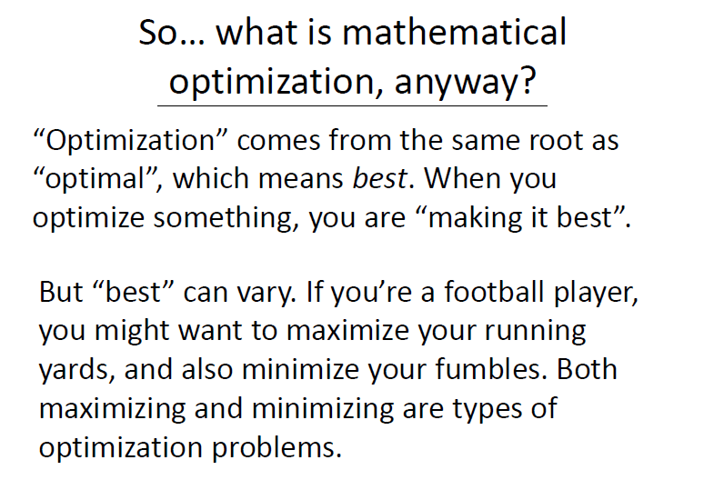

Slide 5
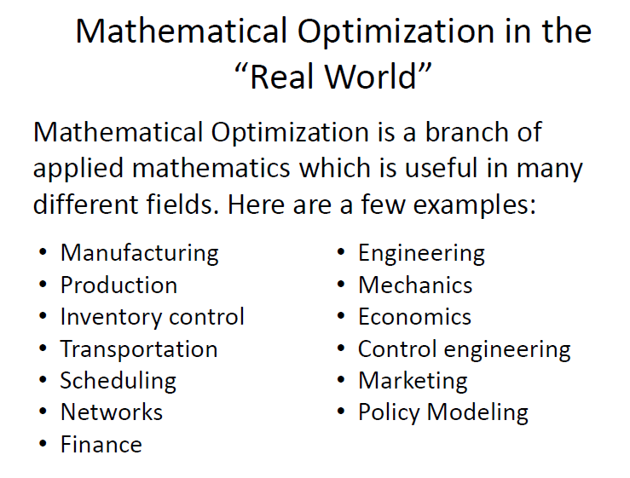

Slide 6
Machine learning is an application of optimization

Slide 7
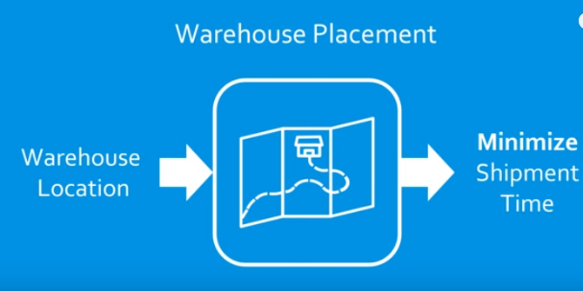

Slide 8
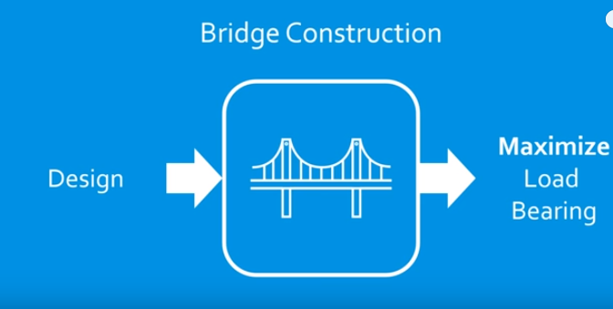

Slide 9
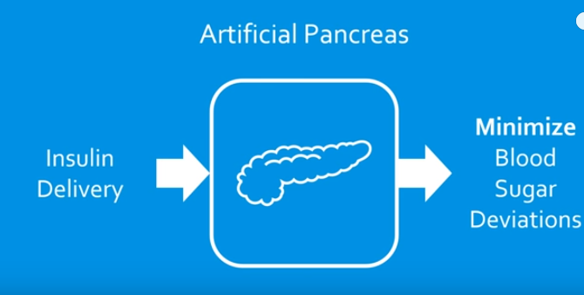

Slide 10
What is Optimization?
Optimization is the mathematical discipline which is concerned with finding the maxima and minima of functions, possibly subject to constraints.

Slide 11
Optimization algorithm
Is a set of steps that is used to solve an optimization problem

Slide 12
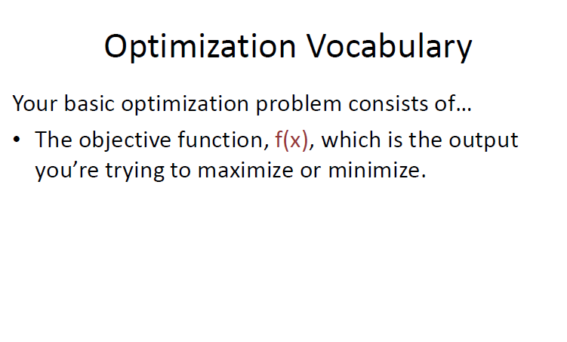

Slide 13
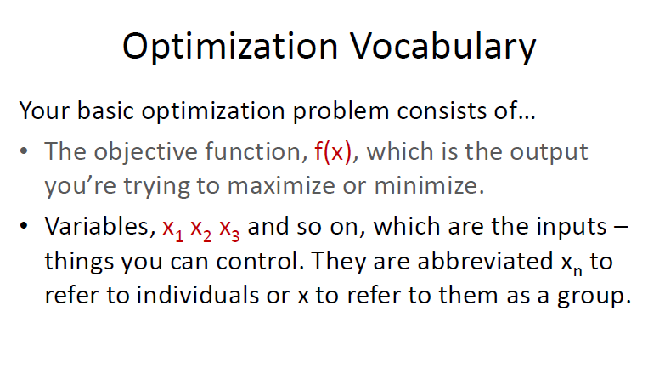

Slide 14
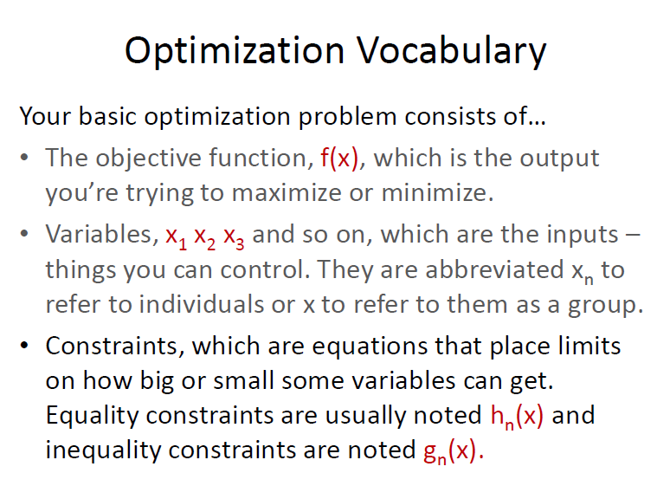

Slide 15
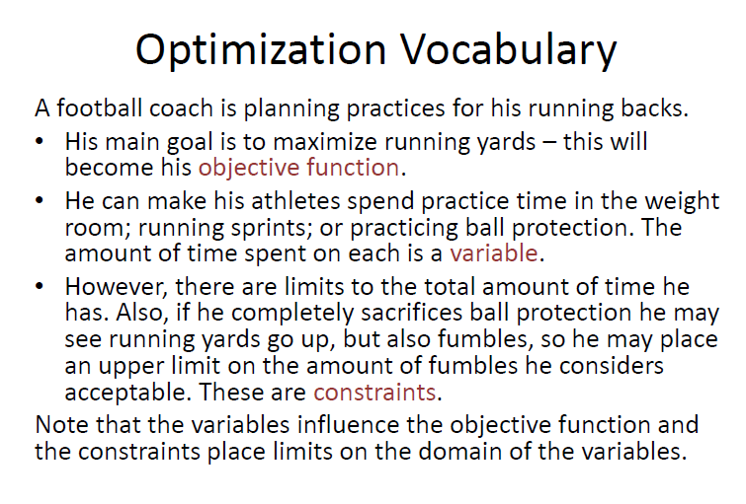

Slide 16
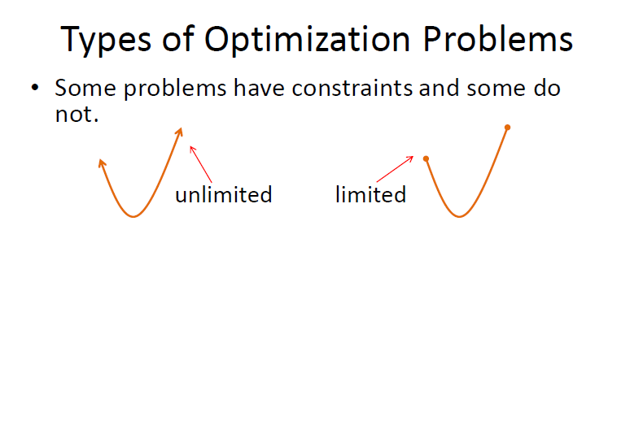

Slide 17
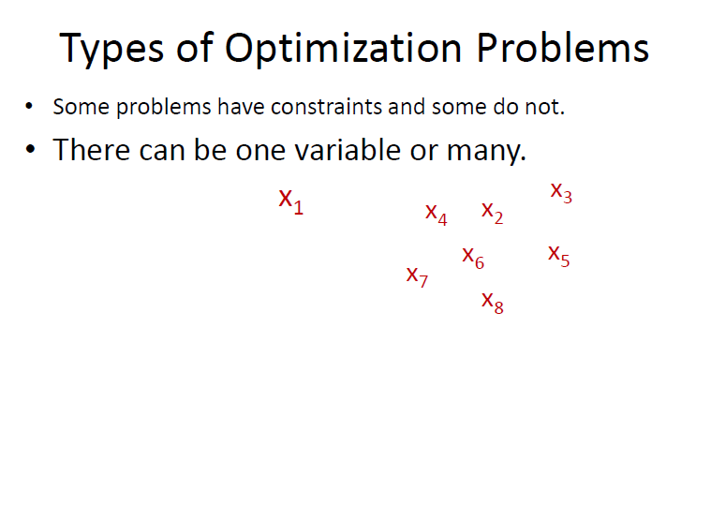

Slide 18
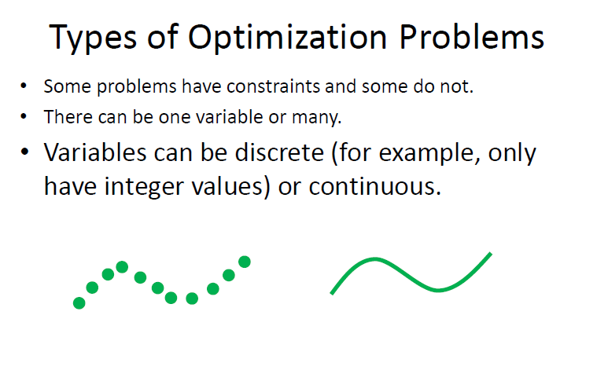

Slide 19
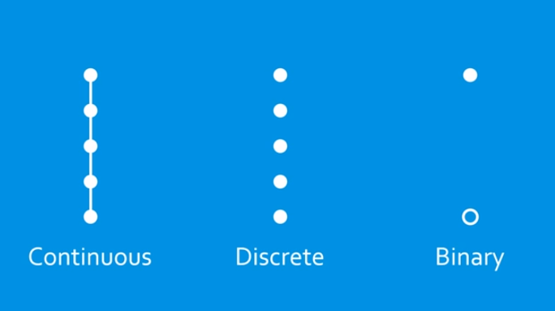

Slide 20
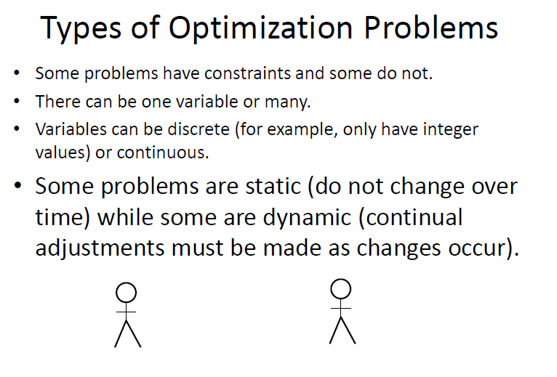

Slide 21
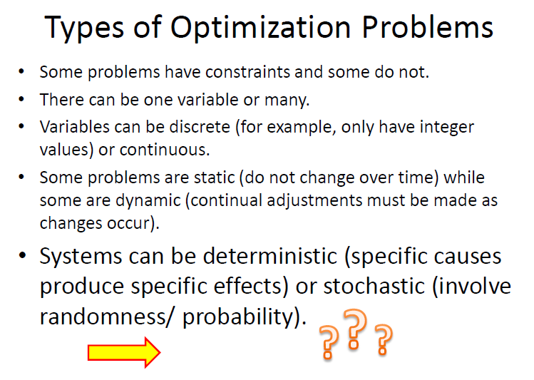

Slide 22
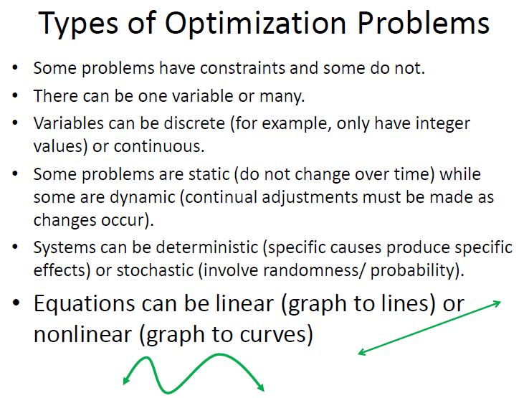

Slide 23
What do we optimize?
A real function of n variables
with or without constrains

Slide 24
Unconstrained optimization

Slide 25
Optimization with constraints
Lagranginan Multipliers may be used to transform the constraints to a dual problem without constraints

Slide 26
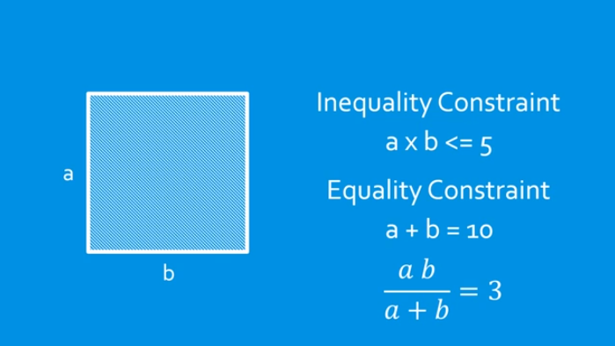

Slide 27


Slide 28
Optimization algorithms
Gradient based algorithms
Gradient free algorithms

Slide 29
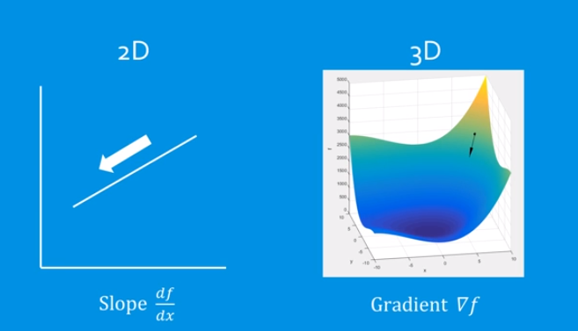
Gradient

Slide 30


Slide 31


Slide 32
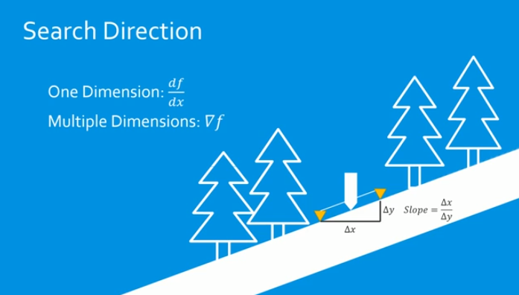

Slide 33


Slide 34


Slide 35


Slide 36
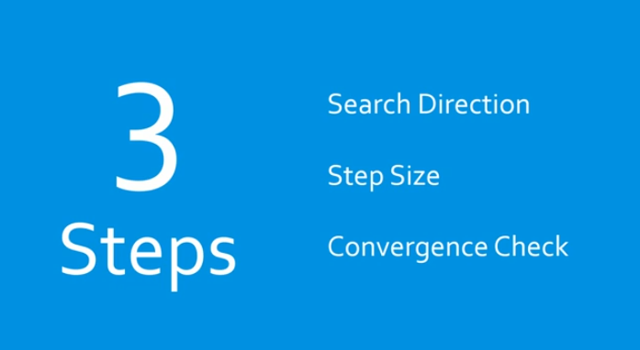

Slide 37
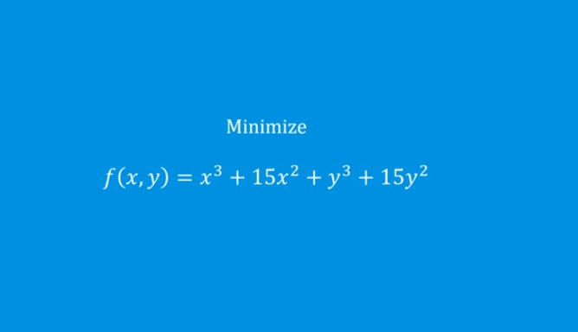

Slide 38
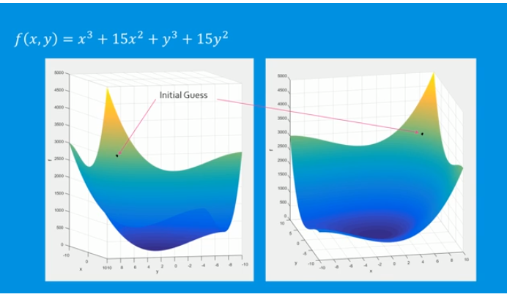

Slide 39
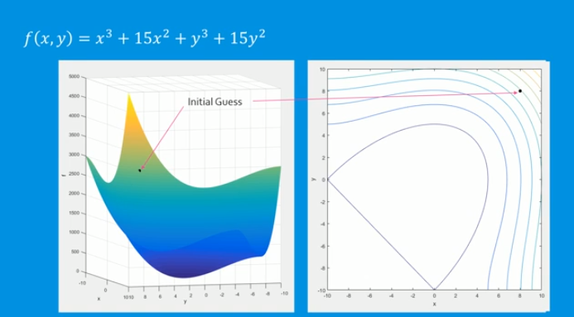

Slide 40
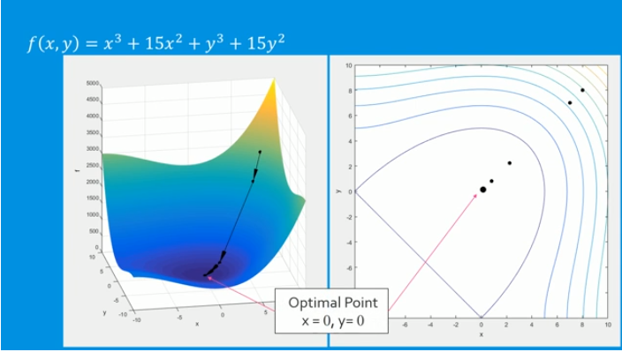

Slide 41
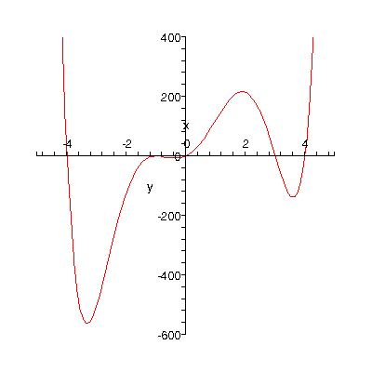
Lets Optimize
Suppose we want to find the minimum of the function

Slide 42
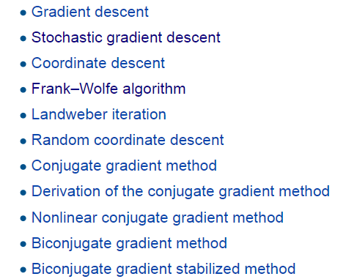

Slide 43
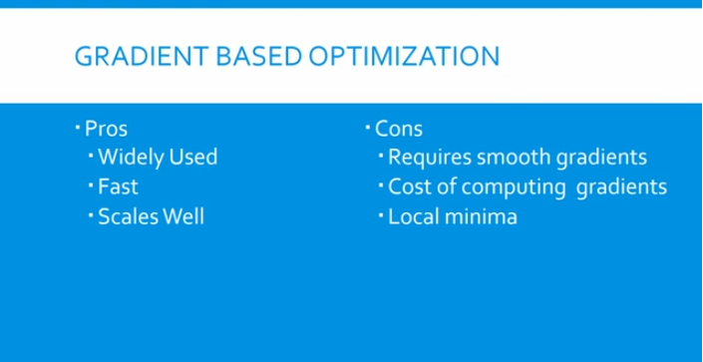

Slide 44
Gradient free algorithms

Slide 45
Do not require derivatives
Can be used for optimization probs where derivatives can’t be used
Makes them more flexible
Generally much slower than gradient based algorithms

Slide 46
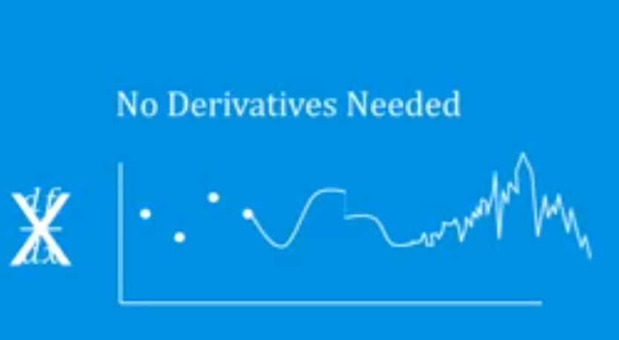

Slide 47
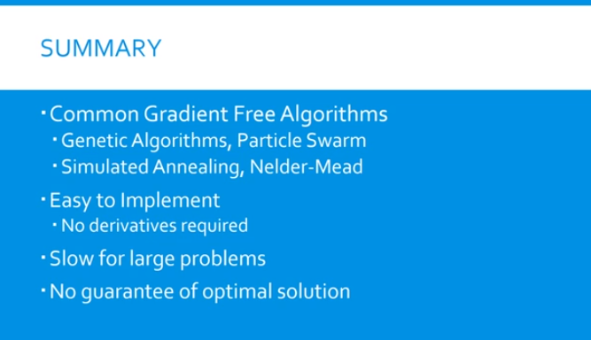

Slide 48
Optimization Cont.
A prerequisite to the use of optimization techniques is to mathematically model a system.
Optimization problem components:
Decision variables
Objective function (to maximize or minimize)
Constraints (requirements or limitations)
Find the values of the decision variables,
that maximize/ minimize object function value,
while staying within the constraint.

Slide 49
Optimization Cont.
A prerequisite to the use of optimization techniques is to mathematically model a system.
Optimization problem components:
Decision variables
Objective function (to maximize or minimize)
Constraints (requirements or limitations)
Find the values of the decision variables,
that maximize/ minimize object function value,
while staying within the constraint.
Single Objective
Multi-Objectives

Slide 50
Optimization Cont.
Feasible Solutions:
Solutions that satisfy all constraints
Optimal Solution:
The feasible solution with the largest objective value (for maximization problems) OR
smallest objective value (for minimization problems)

Slide 51
Optimization algorithms – Another classification

Slide 52
Optimization Techniques – Another Classification
Linear Programming (LP)
- Objective function and the constraints are linear functions of the decision variables
Optimal
Solution
(Mixed) Integer Linear Programming (ILP)
Non-Linear Programming
- Lagrangian techniques
- Karush-Kuhn-Tucker Conditions
Dynamic Programming
- When a problem can be decomposed into sub-problems
Feasible
Solutions
Heuristic Approaches
Genetic Programming
Hill climbing
Iterated Local Search
Simulated annealing
Ant algorithm
Tabu search

Slide 61
Linear Programming - Simplex Method

Slide 62
Linear Programming – Solver demo

Slide 63
Integer Linear Programming (ILP)
Used when the variables have to be integers
MILP (Mixed Integer Linear Programming)

Slide 75
GA - demo

Slide 76
GA – sample code

Slide 77
Multi-objective optimization
Most real-world problems are multi-objective optimization problems
Have to find a trade-off between multiple objectives
One method is to derive a single objective by having a weighted sum of the multiple objectives

Slide 78
Summary
Optimization is the process of finding the optimal set of inputs to maximize an objective function, with or without constraints
Gradient based algorithms
- Gradient descent, Stochastic gradient descent…..
Gradient free algorithms
- Genetic algorithms, simulated annealing….

Slide 79
Summary
Optimal solution - Linear programming, ILP
Feasible solutions (Heuristic based) – Genetic algorithms, Simulated annealing
Machine learning is an application of optimization

